Slide 1
Current leads
Ram C. Dhuley
USPAS – Cryogenic Engineering
June 21 – July 2, 2021

Slide 2
Goals
Learn about the applications of current leads in cryogenic systems
Gain familiarity with different types of current leads
Look at techniques for designing optimal current leads for cryogenic systems

Slide 3
Introduction
Powering a superconducting device involves transfer of current into a cryogenic environment from an outside source. Current leads perform this function.
The current can be DC or RF, and can greatly vary in magnitude depending on the application
  µA – mA DC current for cryogenic sensors
  ~kA DC current for superconducting magnets
  10s of kW of RF (AC) power for SRF cavities
In this lecture, we will focus on
  DC leads for magnets carrying current from room temperature into a LHe environment at ~4.2 K
  RF power for SRF cavities in covered in a separate USPAS class on RF power couplers

Slide 4
Configurations – conventional ‘resistive’ leads
Conventional
“resistive”
Conduction cooled
Vapor cooled
T_{h}
T_{h}
T_{h}
T₁
I, q(l)
Vacuum
Vacuum
T₂
T_{c}
T_{c}
T_{c}
Self cooled
Forced flow
Usually made of low RRR copper
Low material and fabrication cost; lots of design references available
Heat sinking can be tricky; improper design can result in thermal runaway

Slide 5
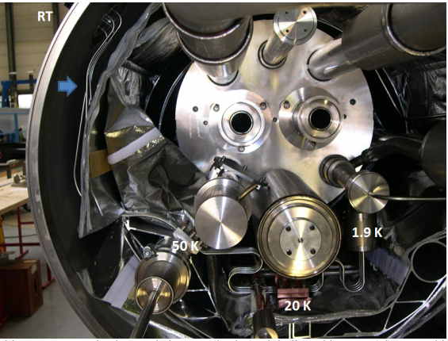
Configurations – conventional ‘resistive’ leads
Resistive current leads for orbital corrector magnet of the LHC
(http://arxiv.org/abs/arXiv:1501.07166 )

Slide 6
Configurations – hybrid ‘resistive + SC’ leads
Hybrid lead
Conduction cooled
Vapor cooled
T_{h}
T_{h}
T_{h}
Resistive
I, q(l)
T₁ << T_{HTS,crit}
Cryocooler
stage 1
Nitrogen in
Vacuum
Helium out
HTS
Cryocooler
stage 2
T_{c}
T_{c}
T_{c}
Resistive: low RRR copper; HTS: Bi-2223 tapes matrixed in Ag-Au alloy
Very low heat leak to 4 K at even at very high amperage
HTS leads must be designed to accommodate a magnet quench or the leads turning resistive; need low resistance contacts at T₁ and T_{c}

Slide 7
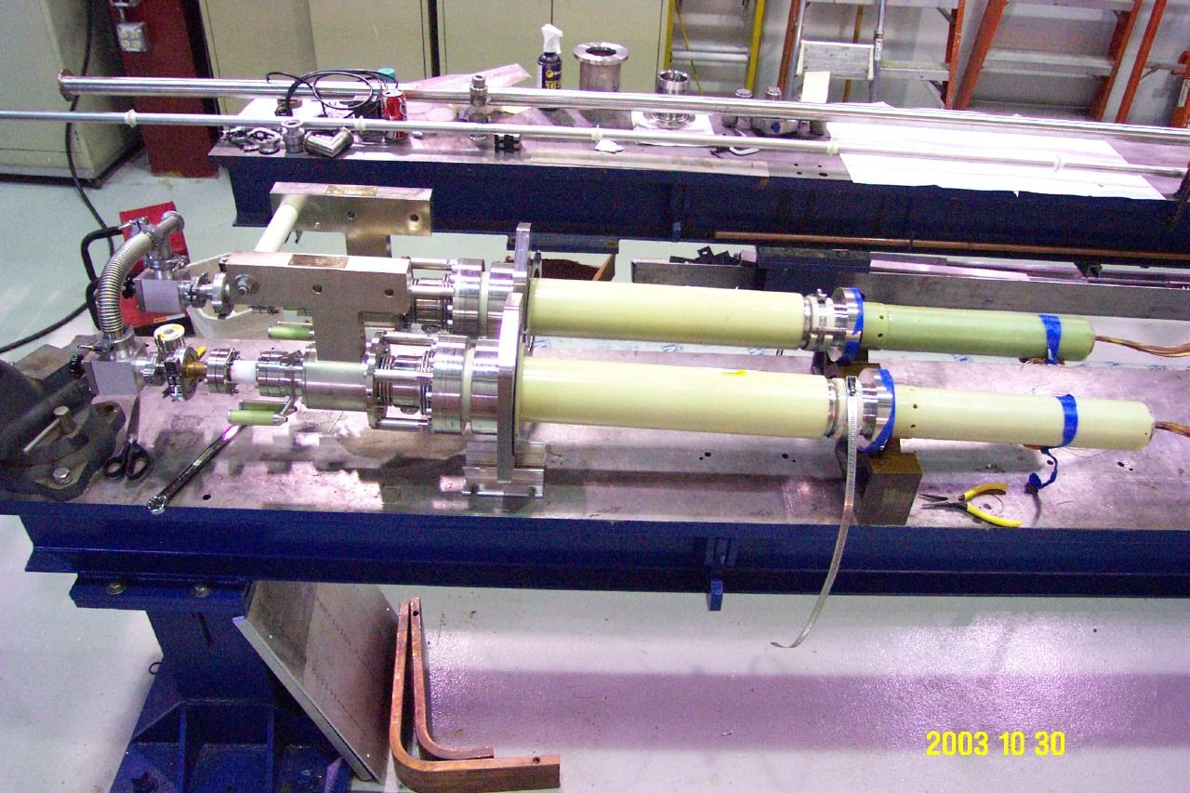
Configurations – hybrid ‘resistive + SC’ leads
Helium cooled, 7.5 kA hybrid leads for LHC inner triplet magnet
power distribution boxes (courtesy: Tom Peterson/SLAC)
Resistive
HTS

Slide 8
Design of resistive current leads
Heat flow definitions
Q_{h} = heat flow entering or leaving the lead from the ambient (T_{amb})
q(l) = heat flow at location x
= q_{cond}(l) + q_{Joule}(l)
Q_{c} = cryogenic load
T_{amb}
l=0
T_{h}
Q_{h}
I, q(l)
Design goal: minimize Q_{c} for a given operating current, I
Parameter space:
Lead dimensions – length, L and cross section, A_{cs}
Lead material – thermal conductivity, k(T) and electrical conductivity, σ(T)
l=L
T_{c}
Q_{c}
vacuum

Slide 9



Design of resistive current leads
T_{amb}
R. McFee (1959) set up a simple 1D model for optimization of resistive leads operating in vacuum.
l=0
T_{h}
Q_{h}
Heat conduction:
I, q(l)
Joule dissipation:
Solution (assuming
constant properties):
l=L
T_{c}
Q_{c}
c = constant of integration
vacuum

Slide 10

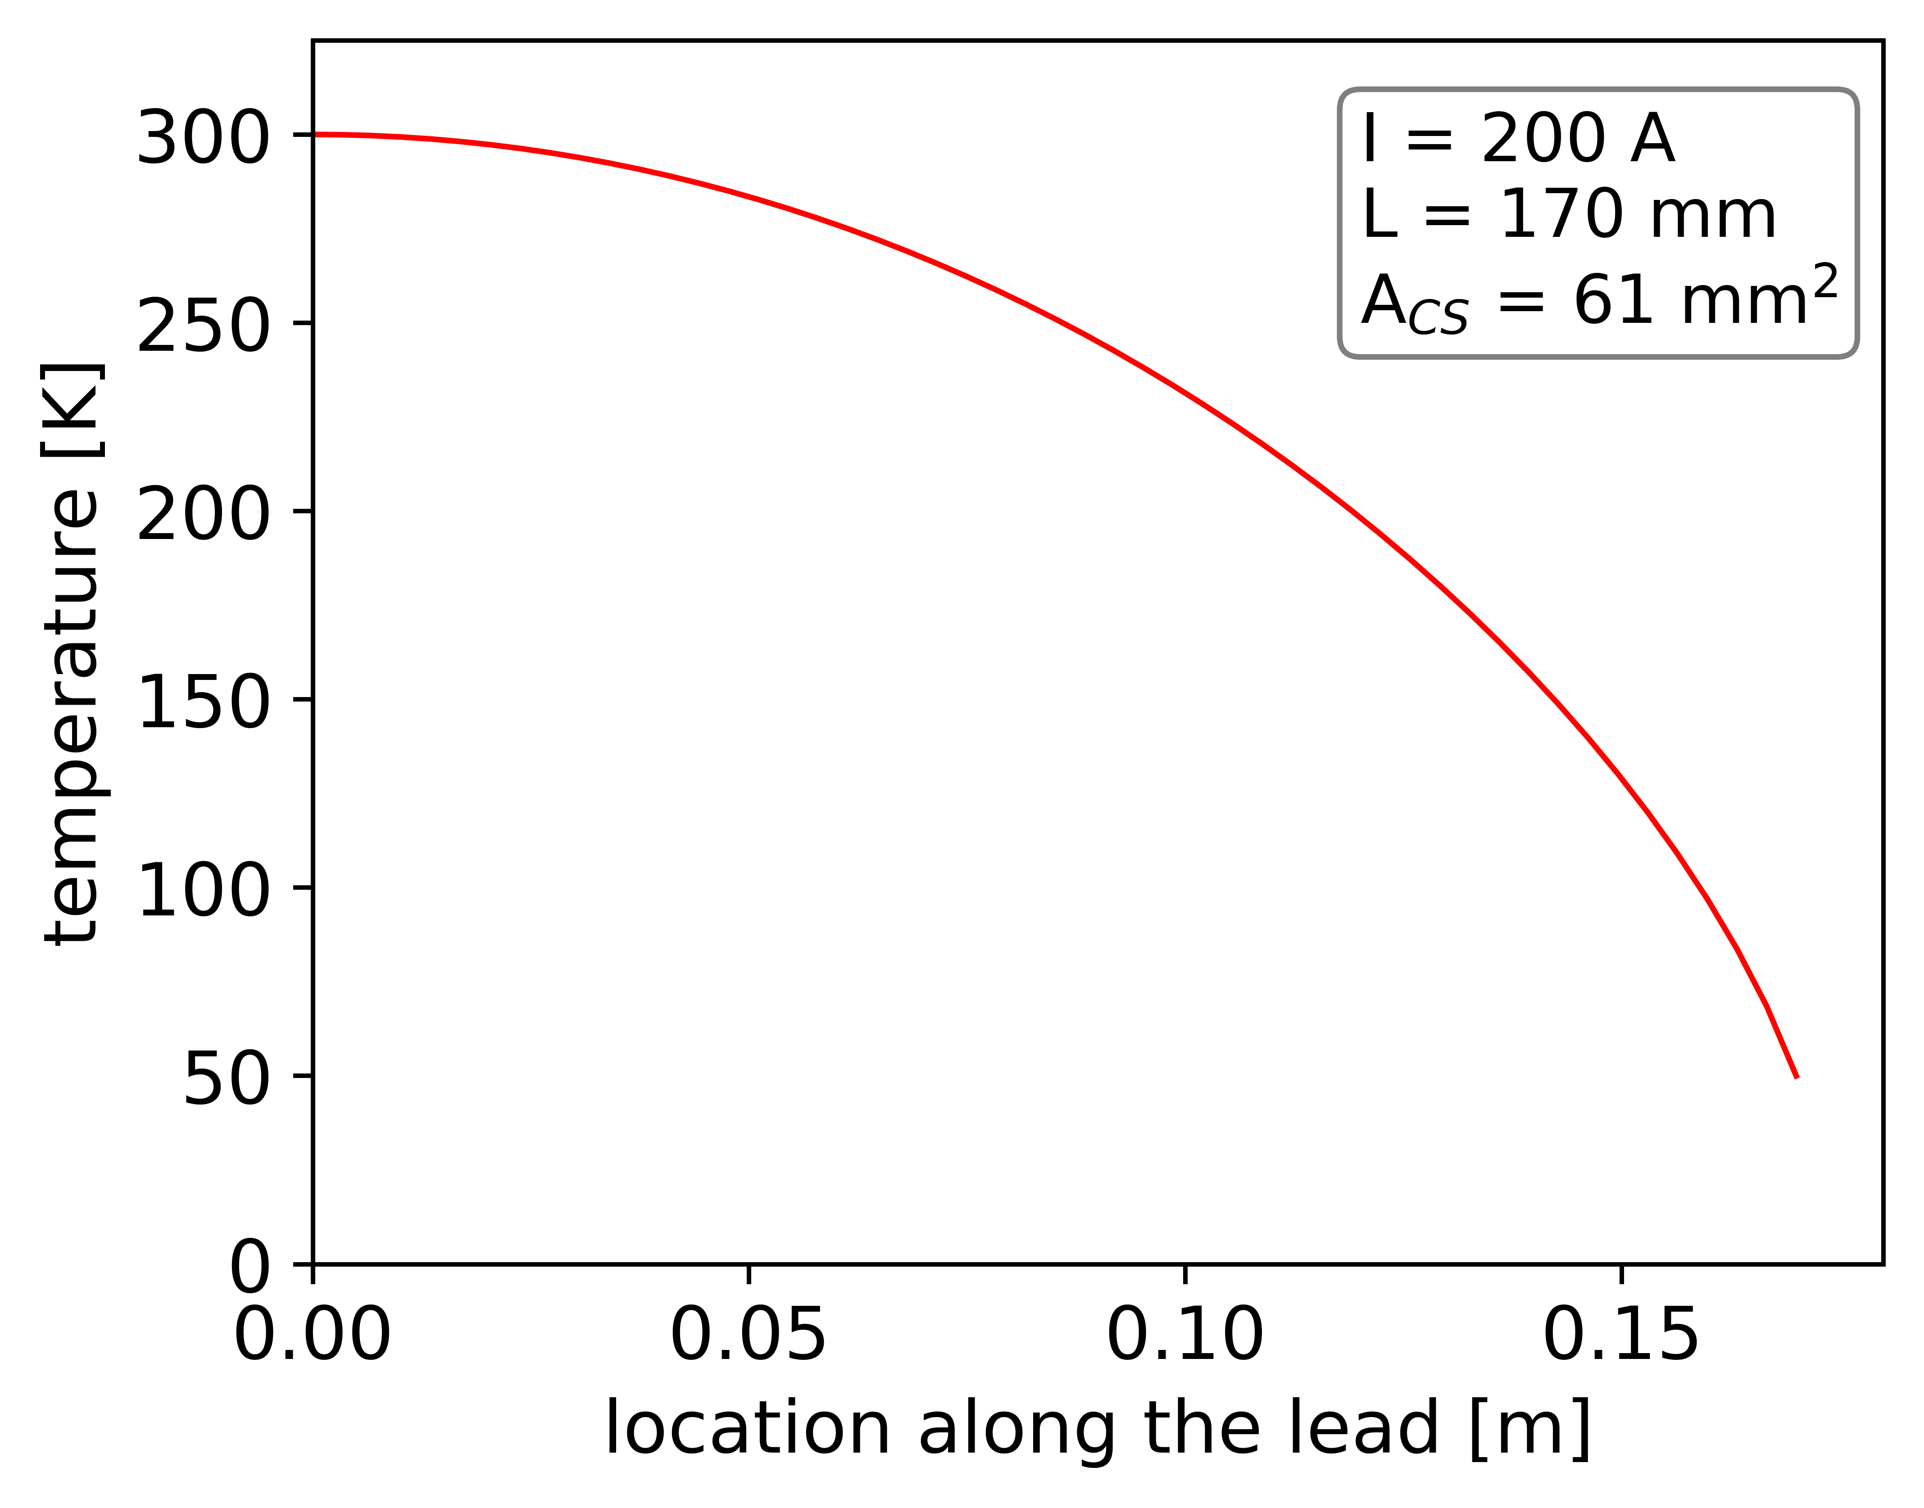

Design of resistive current leads
Conditions for minimum Qc:
The warmest point in the current lead is x = 0 at T = T_{H}
No heat enters the lead at x = 0 (i.e., T_{H} = T_{amb})
Max T = T_{H}
Q_{H} = 0
Lead dimensions for minimum Qc:
For materials that obey Wiedeman-Franz law (k/σ = L₀T),
Q_{L,min} is independent of the material!
However, the L/A for Q_{L,min} depends on the material.

Slide 11
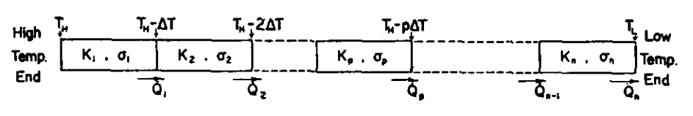
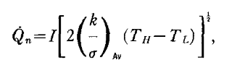
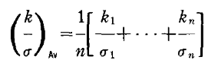
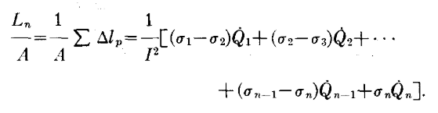
Design of resistive current leads
Solution technique for temperature dependent k and σ:
Q_{L,min}:
L/A for Q_{L,min}:
n ~ 10 gives reasonably accurate solutions

Slide 12




Design of gas cooled resistive current leads
1D model for self-cooled resistive current leads
(http://arxiv.org/abs/arXiv:1501.07166)
T_{amb}
Energy balance
for the lead
Q_{h}
Energy balance
for coolant gas
I, q(l)
Coolant boiloff
rate
l=L
T_{c}
Q_{c}
Assuming
perfect heat
exchange (large h)

Slide 13
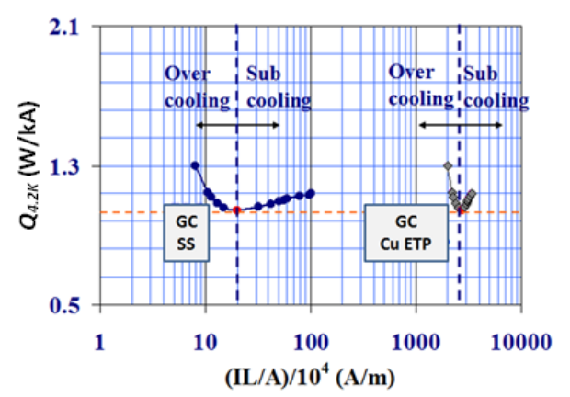
Design of gas cooled resistive current leads
Gas cooled leads also need Q_{H} = 0 to minimize Qc (like conduction cooled leads)
Q_{c,min} independent of material
L/A for Q_{c,min} depends on material
(http://arxiv.org/abs/arXiv:1501.07166 )

Slide 14
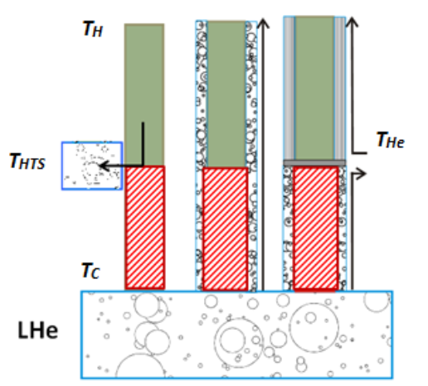
Design of hybrid current leads
The optimization of a hybrid current lead is done in two parts:
Resistive part
  Procedures described earlier
HTS part considerations
  Choice of HTS and matrix material and their size (L/A) to minimize conduction heat leak
  Parallel shunt for current discharge during quench
  Use configurations less sensitive to self-fields (eg. Bi2223 tapes are wound cylindrically to make the self-field parallel to the plane of the tapes)

Slide 15
Practical design considerations
The analytical models presented earlier are a good starting point
However, final optimization a current lead designed for transferring high currents must include 2D and possibly 3D finite element calculations for the detailed definition of the
geometry
Consider the modelling of
  thermal performance – temperature dependent thermal conductivity, heat transfer coefficient
  electrical performance – temperature dependent electrical resistivity, shunt for HTS leads
  fluid dynamic performance – pressure drop for gas cooled leads
  Magnetization of HTS leads in self field
Current leads design is a mature topic with lot of literature – take benefit of this for your design!

Slide 16
Examples of HTS leads
Fermilab tested and operated some HTS current leads at 4.5 kA to 6 kA for the Tevatron, and a few of them ran for many years in the Tevatron
  LN2 cooled copper section
  Small helium vapor flow up HTS section
  Very stable and reliable
  Design issues involved solder joints to various conductors (LTS – HTS – copper) and isolation of N2 from helium channels
  See references 3 and 4 for more information

Slide 17
Examples of HTS leads
CERN’s LHC current leads for currents above a few 100 amps are HTS leads, helium gas cooled from nominally 20 K gas
  See reference 5 for more information
The Fermilab/Berkeley collaboration incorporated 7.5 kA HTS current leads into the DFBX feed boxes for the LHC inner triplet magnets, also helium cooled
  http://tdserver1.fnal.gov/peterson/tom/DFBXimages/HTSleads/index.html

Slide 18
References and further reading
R. McFee, “Optimum Input Leads for Cryogenic Apparatus,” Review of Scientific Instruments, 1959.
A. Ballarino, “Current Leads, Links, and Buses,” http://arxiv.org/abs/arXiv:1501.07166.
G. Citver, S. Feher, T.J. Peterson, C.D. Sylvester, “ Thermal Tests of 6 kA HTS Current Leads for the Tevatron,” Advances in Cryogenic Engineering, Vol. 45B, pg. 1549.
J. Brandt, S. Feher, T.J. Peterson, W.M. Soyars, “HTS Leads in the Tevatron,” Advances in Cryogenic Engineering, Vol. 47A, pg. 567.
T.P. Andersen, V. Benda, B. Vullierme, “600 A Current Leads with Dry and Compact Warm Terminals,” LHC Project Report 605.

